Slide 1
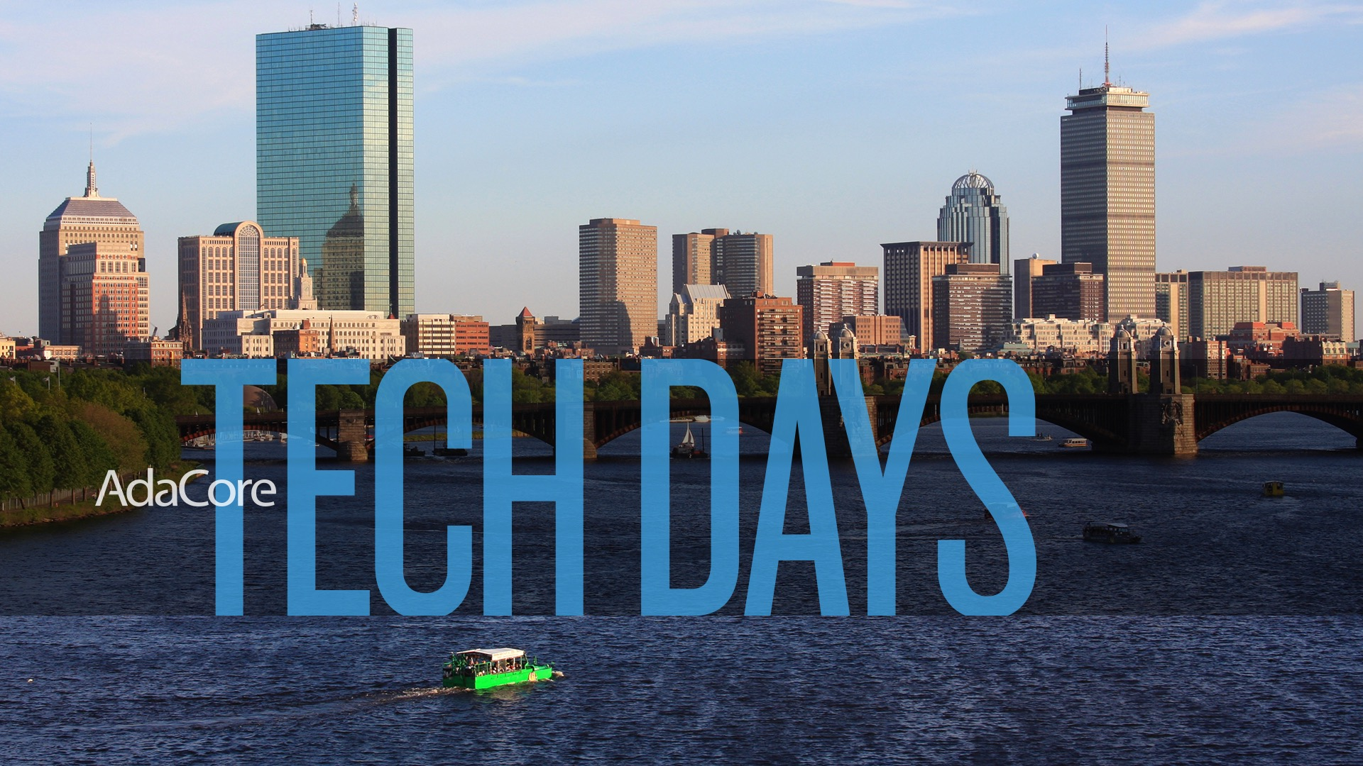
Boston (Burlington), Mass. November 14-15, 2018

Slide 2
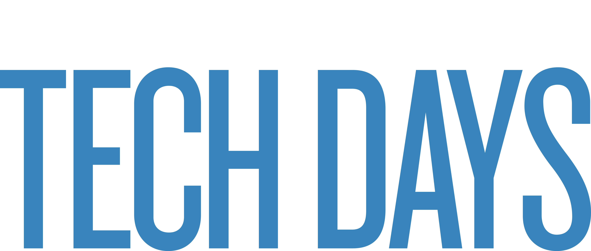
Welcome / Agenda
Ben Brosgol
14 November 2018

Slide 3
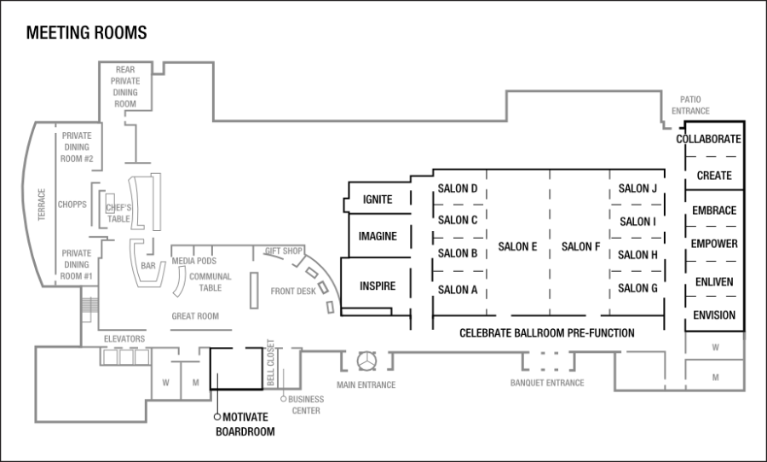
What’s Happening Where?
Food-Related Events
Conference Sessions

Slide 4
Wednesday Morning, November 14
7:15 – 8:45 am  Breakfast
9:00 – 10:00 am
Welcome  Ben Brosgol
Keynote- Assured Software: A Journey and Discussion  Bob Martin (The MITRE Corp.)
10:00 – 10:30 am  Break / Demos
10:30 am – 12:00 Noon
Covering CWE with Programming Languages and Tools  Rob Tice
Demo: CodePeer  Rob Tice
Market Perspective  Jamie Ayre
12:00 Noon – 1:30 pm  Lunch

Slide 5
Wednesday Afternoon, November 14
1:30 – 3:00 pm
GNAT Pro Update  Arnaud Charlet
General Programming on Graphical Processing Units  Quentin Ochem
Integrating GPS into Your Workflow  Nico Setton
C / C++ Offering  Rob Tice
3:00 – 3:30 pm  Break / Demos
3:30 – 5:00 pm
AdaCore Technologies for Cyber Security  Yannick Moy
Technology Adoption Services  Michelle Ricardo
CodePeer Update  Arnaud Charlet
5:00 – 8:30 pm  Reception and Dinner

Slide 6
Thursday, November 15
7:15 – 8:45 am  Breakfast
9:00 – 10:30 am
Why Switch to the Latest Version of Ada?  Patrick Rogers
Ada / SPARK Community  Raphaël Amiard
Libadalang Update  Raphaël Amiard
Embedded Development  Patrick Rogers
10:30 – 11:00 am  Break / Demos
11:00 am – 12:30 pm
Hidden Gems  Albert Lee
AdaCore Support for FACE™  Ben Brosgol
QGen and TQL Qualification  Tucker Taft
“Open Mic” / Conclusions  Ben Brosgol
12:30 - 1:30  Lunch

