Slide 2
AdaCore C/C++ Offering
Eric Perlade
2018-10-04

Slide 3
Why AdaCore and C/C++?
C and Ada coexist in the same market space
Most applications today are mixed language application
… a consistent environment for all is optimal
Teams may want to have consistent providers across applications, no matter what language
… so we need also to support pure C/C++ applications
We’re using a technology (GCC) fundamentally meant to be multilanguage

Slide 4
Key points of our toolchain
GCC-based technology
Support a wide range of language versions, including C11 and C++17
Provided with the same level of support (GNAT Tracker) as GNAT Pro Ada
Available for mixed language or pure C/C++ development
Verification tools available

Slide 5
Platform Support
 | Native (x86) |  | Embedded (PowerPC, ARM, x86)
 | Linux | Windows | Linux | Bare Metal | VxWorks 6 | VxWorks 7 | Lynx178
C
C++

Slide 6
GNAT Pro Assurance for C/C++
Enterprise
Assurance (on 18)
18.4
18.5
18.2
18.3
18.1
18.0
18.0w
19.0w
2017
2018
2019

Slide 7
GNAT Pro Assurance A solution for long term maintenance
Critical Bug Fixes
Silent code generation error
False negative
Issues hindering production of certification evidence
Active Known Problem Analysis
Analysis of problems identified in other versions
Analysis of problems identified in the community
Additional categorization and justification material
Sustain impact analysis justifications

Slide 8
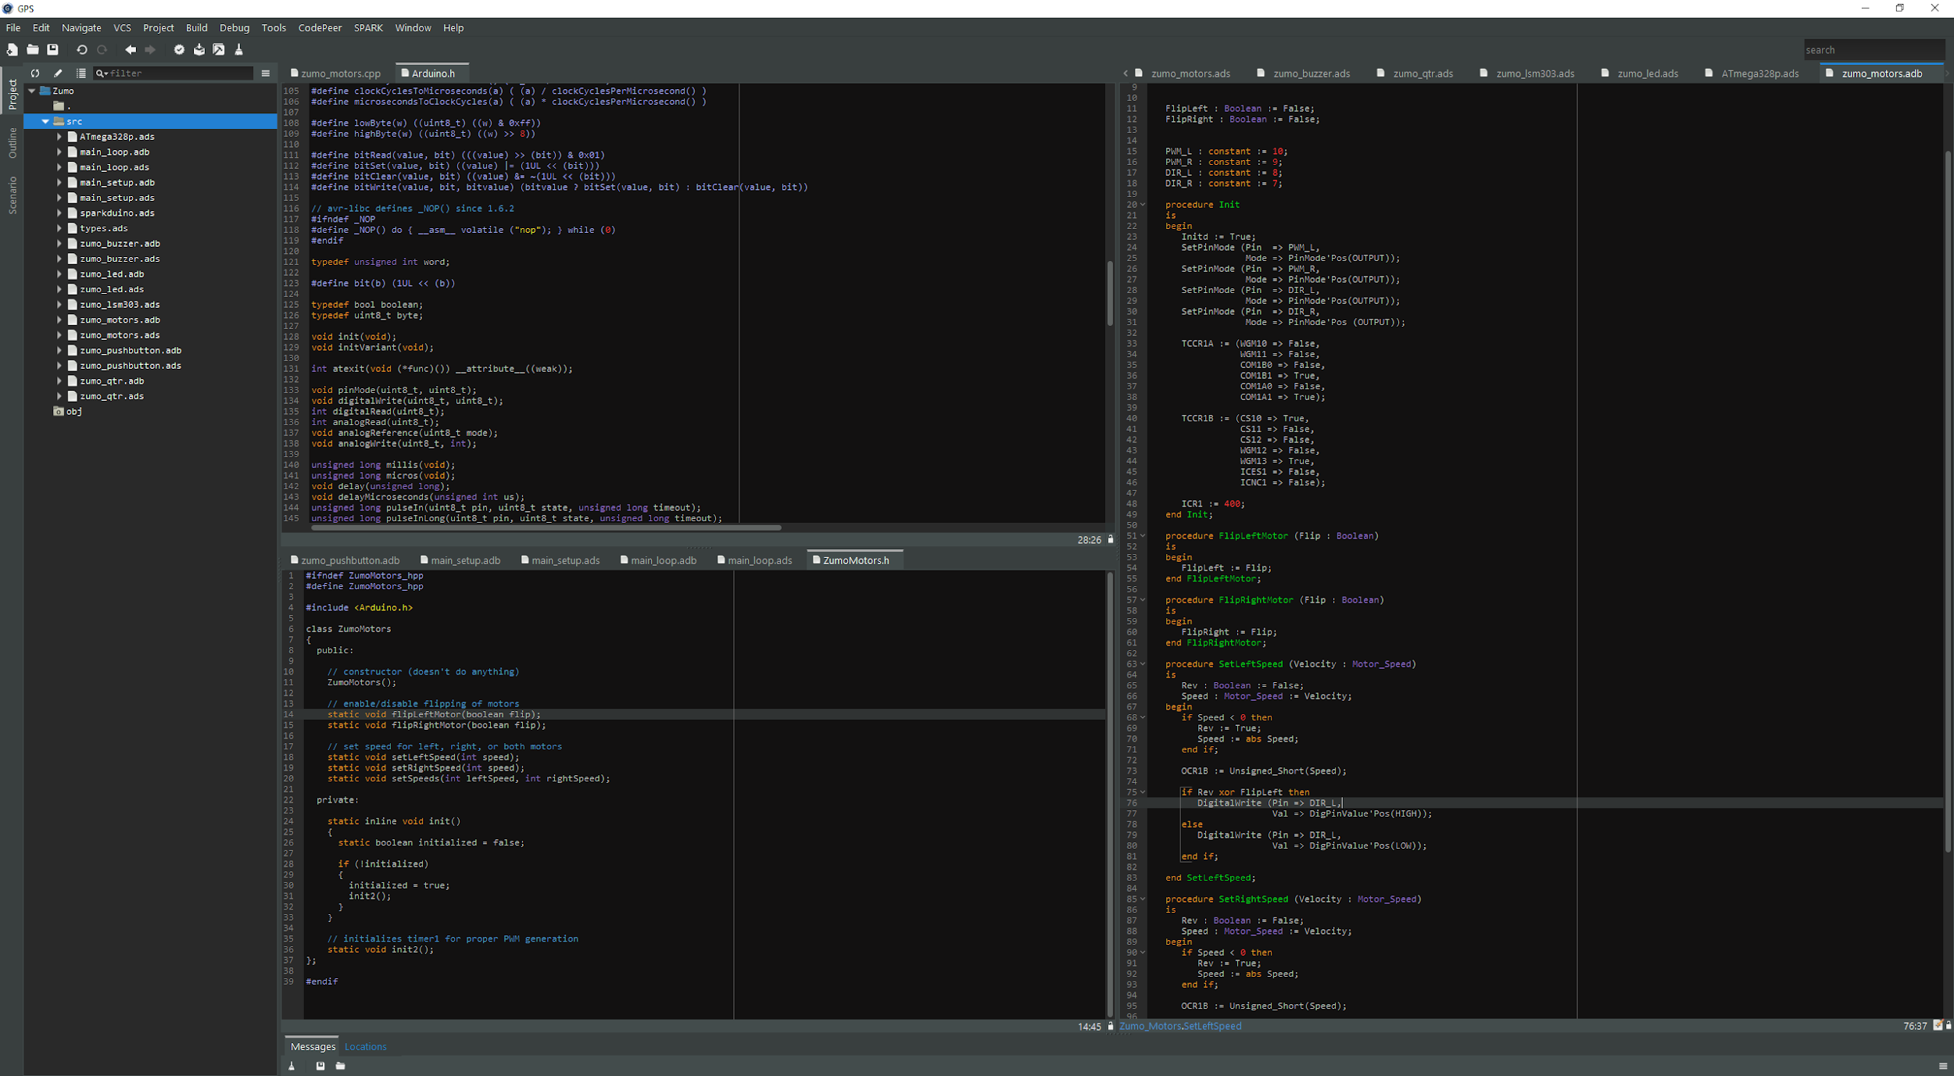
GNAT Programming Studio
Mixed language environment for C, C++ and Ada
Smart edition
Source code navigation (integration with clang)
Integration with build & debug

Slide 9
GNATcoverage
Ada & C Support
HOST
Pure
Functional Test
Windows, Linux Bare Metal ARM / PowerPC
VxWorks 6 PowerPC
Source to Object Traceability Study
GNATemulator / Valgrind / dynamiRIO
Coverage Information
Sources
Executable
Pure
Functional Test
Coverage Data
(no instrumentation)
Statement Decision MC/DC
Ada 83 / 95 / 05 / 2012 C 99
Lauterbarch / iSystems
TARGET

Slide 10
GNATstack
Identification of the worst case of stack usage for each entry point
Available for Ada (up to Ada 2012) and C
Information provided statically
Manual information needs to be provided for
System calls
Recursive calls
Dynamic frames
DO-178 qualification material is available

Slide 11
Endianness Specification
Allows to specify the endianness of a data structure in memory regardless of processor host
Endianness is converted back & forth on read and write operations
Ideal for porting code from e.g. PowerPC to x86 / ARM when communication layers are endianness-specific
struct s {
int a, b;
} __attribute__((scalar_storage_order("big-endian")))
variable;

Slide 12
Ada/C++ Exception Propagation
Calls
Calls
C++
Ada
C++
exception
when others =>
…
raise Y;
catch (…) {
}
throw X;

Slide 13
Mixed Language Build
GPRbuild can drive mixed language builds as long as the project file is declared as supporting those languages
GCC is picked up if available
Other compilers can be configured through GPRconfig
project Mixed is
for Languages use (“Ada”, “C”);
end Mixed;

Slide 14
Ada & C bindings
Importing C code from Ada
Importing Ada code from C
procedure C_Proc; pragma Import (C, C_Proc, "c_proc"); | void c_proc (void) { // some code }
procedure Ada_Proc; pragma Export (C, Ada_Proc, "ada_proc"); procedure Ada_Proc is begin -- some code end Ada_Proc; | extern void ada_proc (void);

Slide 15
Some more Ada & C bindings
Easy to get wrong…
Type R1 is record V : int; end record with Convention => C; procedure F1 (P : R1); pragma Import (C, F1, "f1"); | struct R1{ int V; }; void f1 (R1 p);
Type R1 is record V : int; end record with Convention => C_Pass_By_Copy; procedure F1 (P : R1); pragma Import (C, F1, "f1"); | struct R1{ int V; }; void f1 (R1 p);

Slide 16
Using the Binding Generator
From C to Ada
From Ada to C
gcc –fdump-ada-spec <header files>
gcc –gnatceg <specification files>

Slide 17
Ada/C++ Inheritance
procedure P (V : T’Class) is
begin
V.Method;
end P;
T C++ Base Type
Method
T2 Ada Derived Type
void P (T & V) {
V.Method();
}
Override Method

Slide 18
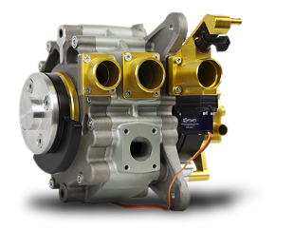
Simulink to C Code Generation
QGen
QGen Code Generation (SPARK Ada or MISRA C)
Target Debugger
Simulink®, StateFlow®
Safe subset of embedded blocks (~120)
Portable across versions
DO178 credit sought on source level traceability, reviews, tests, coverage
(Tables 5, 6, 7)

Slide 19
Ada/SPARK to C Code Generation
GNAT Common Code Generator (CCG)
Allows to develop formally proven code in SPARK and integrate in a C code generation toolchain
C code to be considered as compilation artifacts
Similar to assembly or internal compiler trees
Not meant to be maintainable
Removes constraints on the target architecture supported
Support a subset of SPARK / Ada close to bare metal no-runtime profile

